Slide 1
Lists
Creating a List | Keys
Notes:
Welcome to our lecture on Lists in react. In this lecture we will go through how to create list in react and use of keys in lists. Let’s start the video lecture.

Slide 2
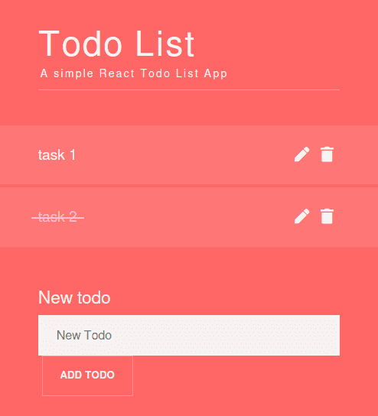
Creating a List
Using map() in JSX: In React, lists are created by mapping over an array and returning JSX elements.
Key Prop: Each item should have a unique key prop to help React efficiently update the UI.
Example: {items.map(item => <li key={item.id}>{item.name}</li>)} generates a list dynamically.
Notes:
Now, let’s explore how to create a list in React. Lists are generated using the map function, which iterates over an array and returns JSX elements. Each list item should include a unique key prop to help React efficiently update the UI. For example, mapping over an array of items and returning list elements dynamically ensures smooth rendering and updates in React applications.

Slide 3
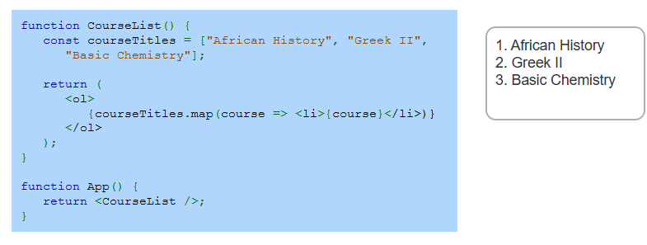
Example
Notes:
Let’s look at this example of creating a list in React. The Course List component defines an array of course titles and uses the map function to generate list items dynamically. Each course title is displayed inside an ordered list. When the component renders, it automatically generates a structured list of courses. This approach makes it easy to manage and display dynamic data efficiently.

Slide 4
Keys
Purpose of Keys: Keys help React identify and update list items efficiently when changes occur.
Unique Identifiers: Typically, a unique ID is used as a key; if unavailable, the array index can be used as a fallback.
Scope of Uniqueness: Keys must be unique among siblings but can be reused in different lists.
Notes:
Now, let’s discuss the importance of keys in React lists. Keys help React efficiently track and update list items when changes occur. A unique ID is typically used as a key, but if none is available, the array index can be a fallback. Keys must be unique among sibling elements but can be reused in different lists. Proper key usage improves performance and prevents unnecessary re-renders.

Slide 5
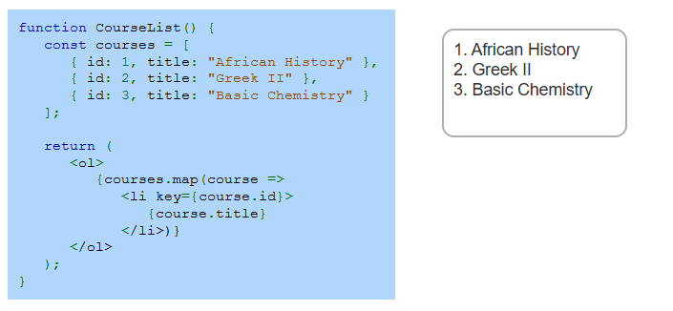
Example
Notes:
Let’s examine this example of using keys in a list. The Course List component maps over an array of course objects, each containing an id and a title. The key prop is set to course.id, ensuring each list item has a unique identifier. This helps React efficiently track and update list items when changes occur. Using unique keys improves performance and prevents unnecessary re-renders.

